Slide 1
Calculator application

Slide 2
objective
To build a basic calculator application capable of performing arithmetic operations like addition, Subtraction, multiplication and division. Use stack data structures to handle arithmetic expressions and evaluate them correctly.

Slide 3
MODULES
Build the program code using stack in Python to perform the arithmetic operation.
Get the input from the user and make it more interactive.
Develop an attractive Web page using HTML, CSS and JS and link the application program with it

Slide 4
Explanation
Tokenize the Input: This function will convert the input string into numbers and operators.
Convert Infix to Postfix Notation The infix_to_postfix: Function is used for converting the expression from infix to postfix notation using Shunting Yard Algo.
Question 2 : Evaluate Postfix Expression (Implement a stack in it to run the program) [as C++]SolutionYou can use this new python code which uses Stack and read through logic posted [...]

Slide 5
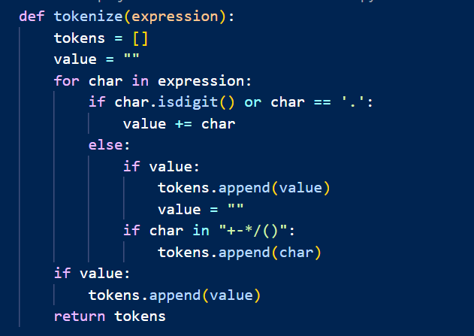
Step 1: Tokenize the Input

Slide 6
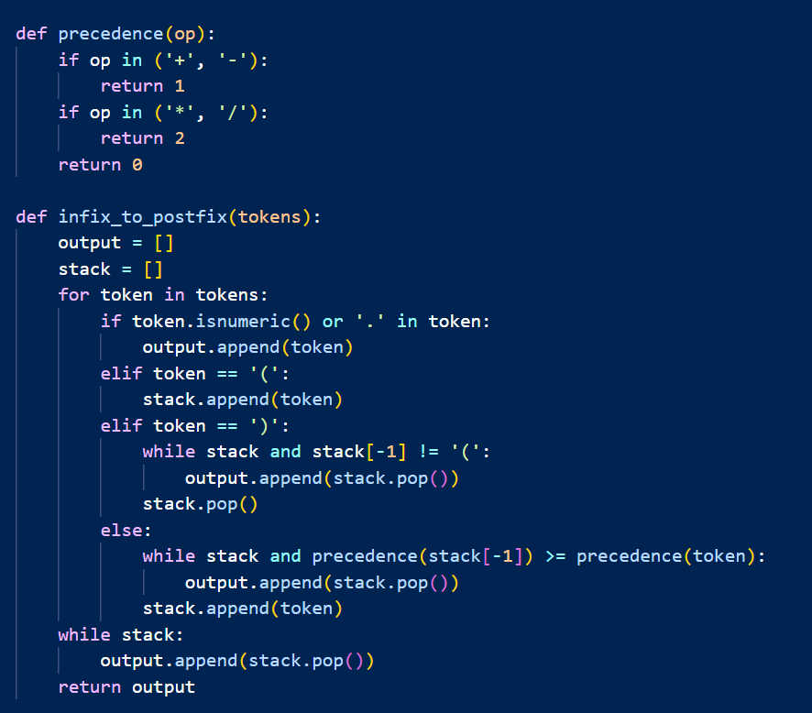
Step 2: Convert Infix to Postfix Notation

Slide 7
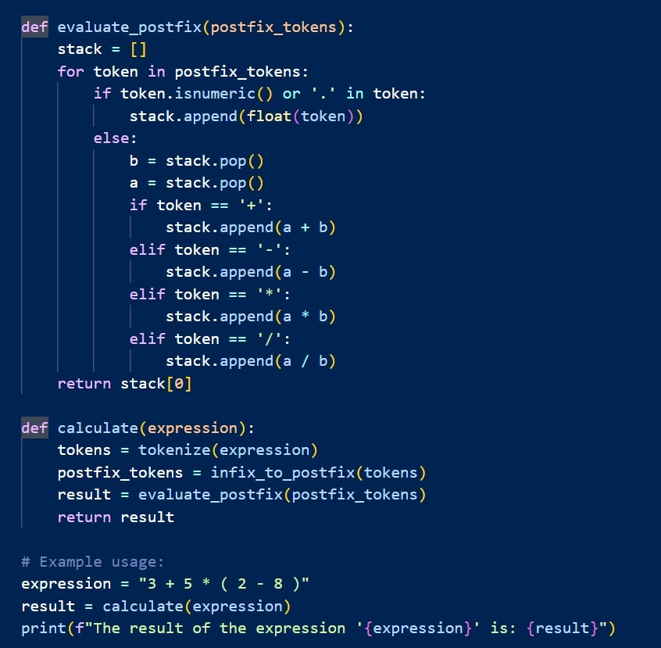
Step 3: Evaluate the Postfix Expression

Slide 8
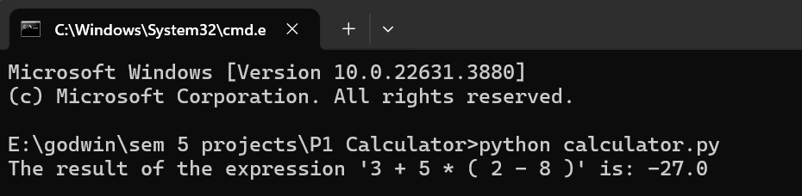
Temporary output

Slide 9
Thank You

